Slide 1
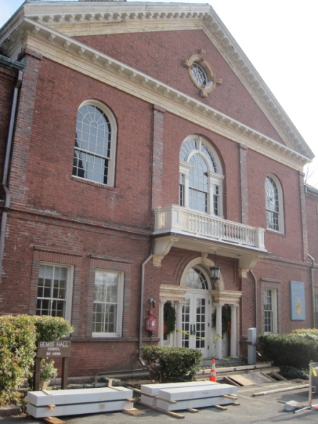
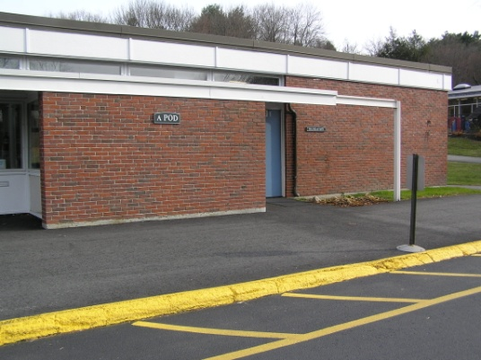
Community Center Feasibility Committee
Report to Annual Town Meeting
March 24, 2012

Slide 2
Community Center Feasibility Committee
Bob Sutherland
Susie Collins
John Ritz
Cathy Long
Nancy Torti
Noah Eckhouse
Dan Pereira (ex officio, non-voting)
Carolyn Bottum (ex officio, non-voting)
Tim Higgins (ex officio, non-voting)

Slide 3
Committee Charge from Selectmen
Evaluate COA, P&R program and space needs
Inventory existing programs and facilities
Identify limitations of existing facilities
Review options for:
Addressing existing limitations
Co-locating programs
Relocating programs to other town or private facilities
Identify and assess potential sites for a new facility

Slide 4
Basic Parameters
First phase of a longer-term project
Committee’s role: information gathering, issues assessment, exploratory
For any option:
Technical studies needed(e.g., architectural, engineering)
Partially depends on outcome of K-8 School Building Study
Town Meeting decides

Slide 5
Potential Sites & Assessment Criteria
Hartwell Area
Smith School
Pierce House
Bemis Hall
First Parish Church
The Groves
Wells Road
Farrington Memorial
DeCordova
Adaptability of existing buildings
Location
Access, circulation, parking
Ease of providing town services
Environmental impact
Zoning, code
Potential cost

Slide 6
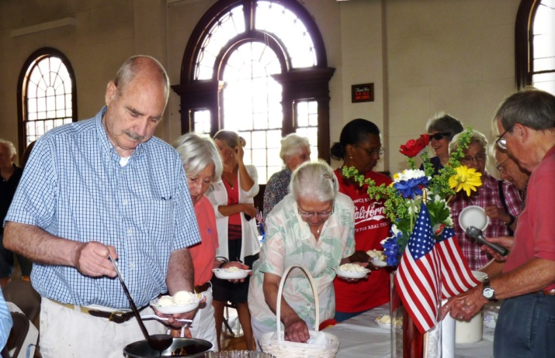
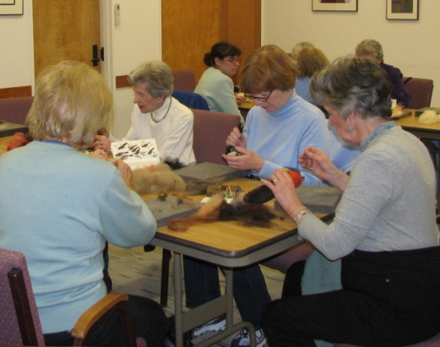
Progress
Community consultation
Focus group
Community meeting
Site visits
Existing inventory
Projected future space needs
Potential alternatives
“Do nothing”
Decentralize
Co-locate

Slide 7

Project Schedule
Key Dates
06/30/11: CCFS kick-off
07/21/11: CCFS meeting #2
08/08/11: CCFS meeting #3
09/15/11: CCFS meeting #4
09/26/11: Board of Selectmen
10/04/11: Focus Group
10/13/11: CCFS meeting #5
10/29/11: State of the Town
11/02/11: CCFS meeting #6
11/17/11: Public Meeting, Hartwell A Pod
12/01/11: CCFS meeting #7
02-03/12: Visits to area community centers
03/06/12: CCFS meeting #8
04/15/12: Draft Final Report

Slide 8
Next Steps
Finish draft report
Present report to Board of Selectmen
Selectmen decide whether to pursue a formal feasibility study – and if so, when

