Slide 1
Community Space Needs
Presentation to the State of the Town Meeting
Saturday, November 9, 2013

Slide 2
COA Space Needs
According to the Town and federal census, residents 60 and over now 29% compared to 22% a decade ago; elder needs more complex; elder services evolved
2012 report: Bemis Hall “not well suited for a senior center.” 2008 needs assessment: “determined that Bemis Hall not be the long term home for the COA”
Not enough space for “drop-in” or activities
Notes:
Carolyn

Slide 3
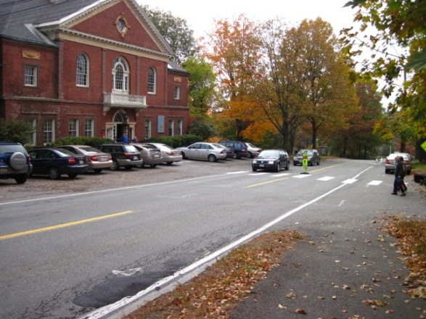
Lack of confidentiality
Lack of accessibility
Lack of parking and crossing Bedford Rd unsafe
Bemis Hall not built to be a modern senior center with myriad programs and services
Notes:
Carolyn

Slide 4
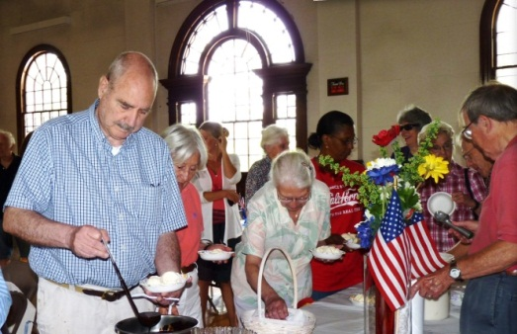
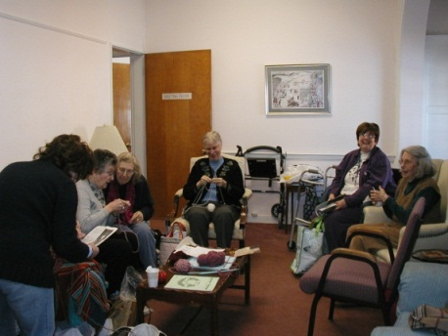
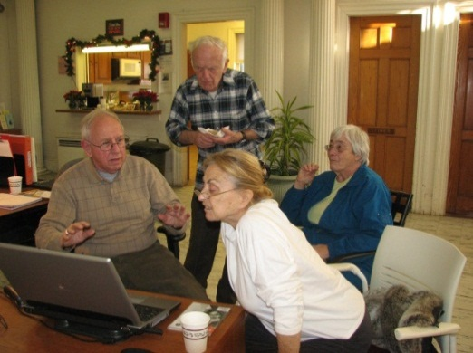
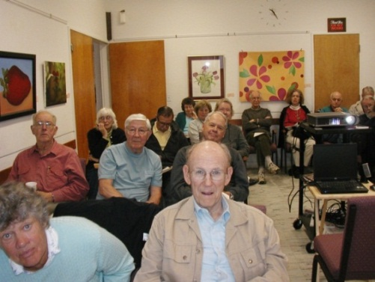
COA – more and better space needed for meeting social needs, activity and fitness rooms, multipurpose room, confidential space, offices
Notes:
Carolyn

Slide 5
Maintaining Status Quo: COA
ADVANTAGES
The basement allows for some expansion
Cost effective
The building is a beautiful facility
DISADVANTAGES
Public safety issues related to parking and Bedford Rd
Lack of adequate parking or space for more
Building cannot be made fully accessible
Lack of space, even with basement, means that essential functions, such as social drop-in, cannot be offered, social services cannot be given confidentially, and already COA cannot provide all activities requested by seniors
Notes:
Carolyn

Slide 6
Senior population is growing
There are safety concerns and logistic problems involved with operating multiple programs in off-site locations
Lincoln will need to invest or is currently investing to upgrade the building regardless
Notes:
Carolyn

Slide 7
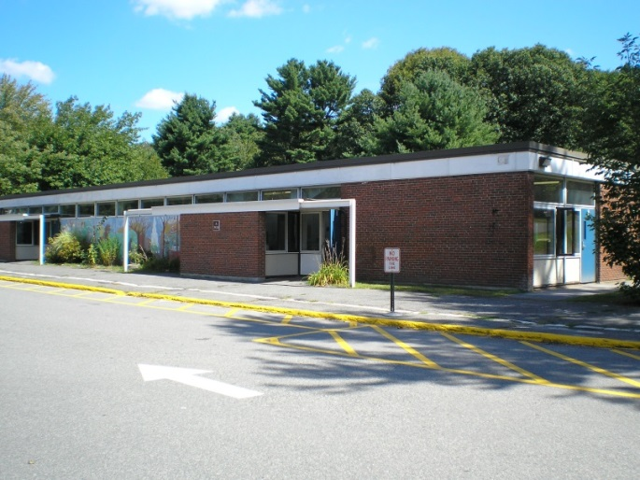
Parks and Recreation Space Needs
Parks and Recreation (PRD) serve over 1,200 residents annually, and over 2,300 residents in the last 5 years. They are happy in the Hartwell Pods:
Good amount of square footage
Proximity to schools is essential
Pods were built in the 50’s and
60’s as temporary spaces.
They need significant work:
Cosmetic and structural issues
Not appropriately handicap accessible
Parking is challenging at certain times of day
As the Schools make decisions about the future of the campus, the Pods remain open for consideration.
Notes:
Dan

Slide 8
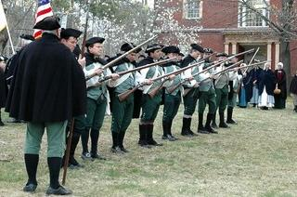

Community Organization Needs
Along with a variety of PRD/COA programs, Bemis Hall and the Pods house about 25 community organizations annually, including:
Lincoln Cub Scouts, Boy Scouts, Brownies, Girl Scouts
Lincoln Minute Men
Lincoln Garden Club
Lincoln Family Association
Lincoln Youth Soccer
Friends of the Lincoln Library
Lincoln Extended Activities Program
Magic Garden Preschool
Lincoln Historical Society
Lincoln Preschool
Notes:
Dan

Slide 9
Maintaining Status Quo: PRD
ADVANTAGES
Location adjacent to fields, courts and pool is ideal
The Pods buildings themselves provide critical space for community programs and overflow school programs.
Programs located both at the Pods and in off-site locations appeals to some residents.
At most times, the number of parking spaces on site is adequate for PRD’s needs although that may change as campus preschool needs change
DISADVANTAGES
Limited opportunities for intergenerational interaction
No operating efficiencies that come with a shared facility
Limited budget for routine cleaning or maintenance
Capital investments are needed, but can’t be determined until we decide what to do with the buildings for the long-term.
Notes:
Dan

Slide 10
A Community Center
One building for COA, PRC, and Community groups
Each department would have designated space for offices and certain activities, and shared spaces for other activities including community groups
COA and PRC schedules are complementary to allow of efficiency of space and parking
The community would benefit from being able to offer additional types of programming such as:
Dedicated fitness center
Educational kitchen for cooking classes
Arts and crafts studio
Informal gathering spaces
Notes:
Carolyn

Slide 11
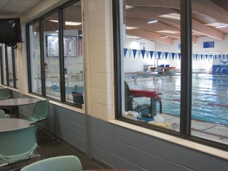
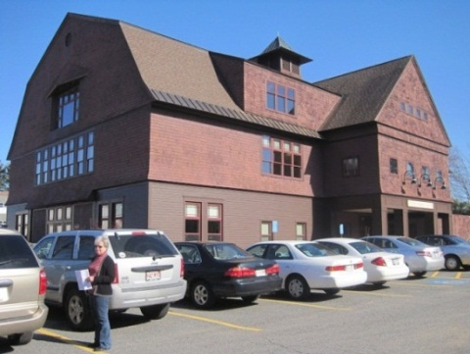

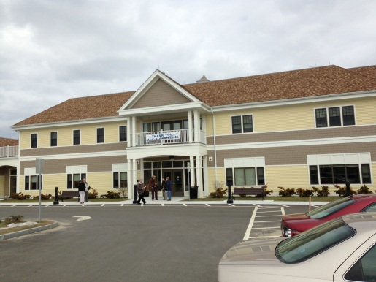
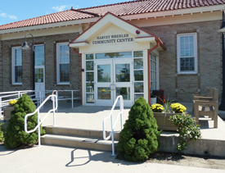
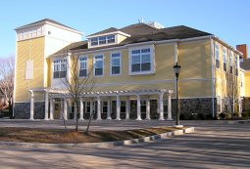
Nearby Community Centers
Weston
Sudbury
Natick
Bedford
Concord
Notes:
Carolyn

Slide 12
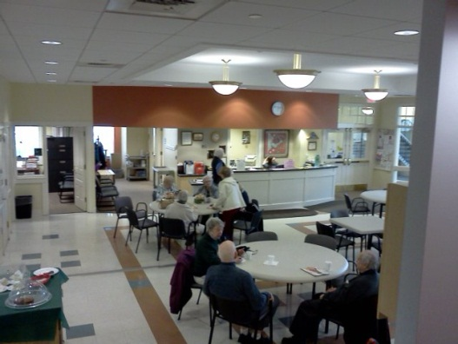
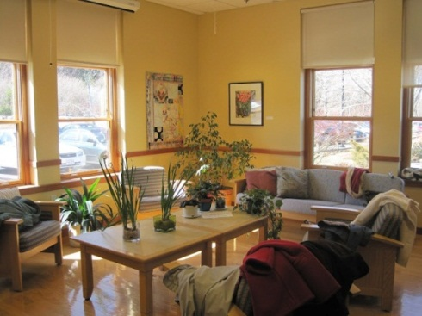
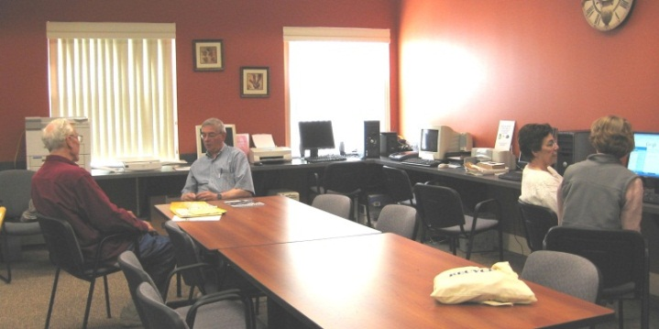
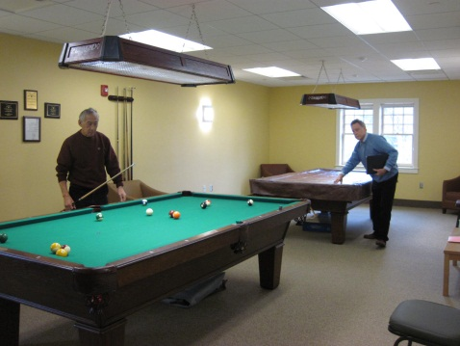
COA Space
Main Room, Bedford
“Living Room,” Weston
“Reading Room”, Bedford
Game Room, Natick
Notes:
Carolyn

Slide 13
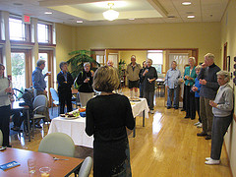
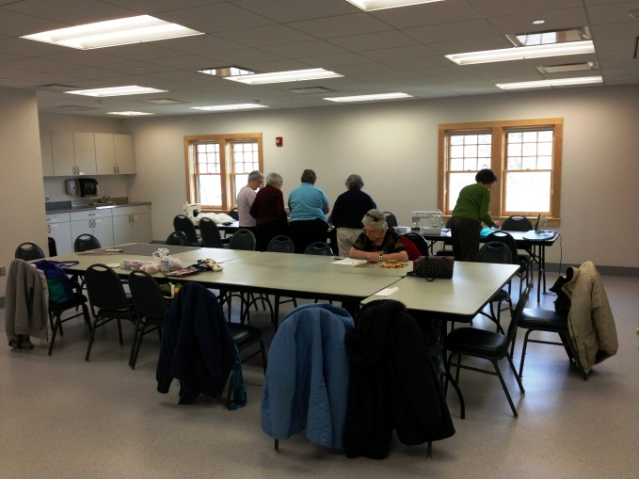
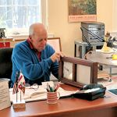
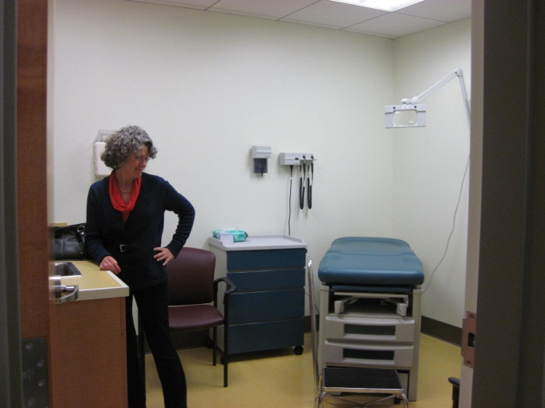
Activity Space, Weston
Activity Space, Natick
Health Room, Natick
“Fix It Shop”/Art Studio, Bedford
Notes:
Carolyn

Slide 14
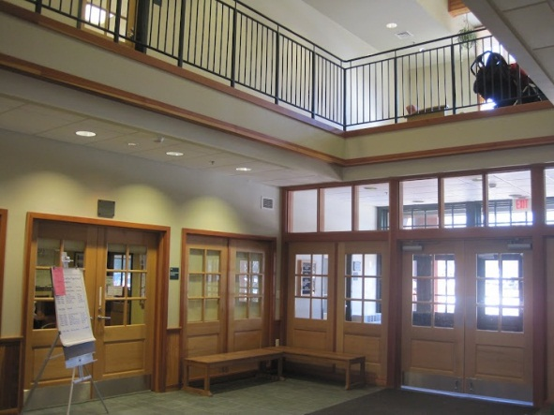
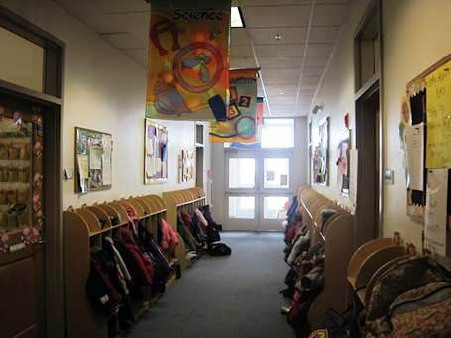
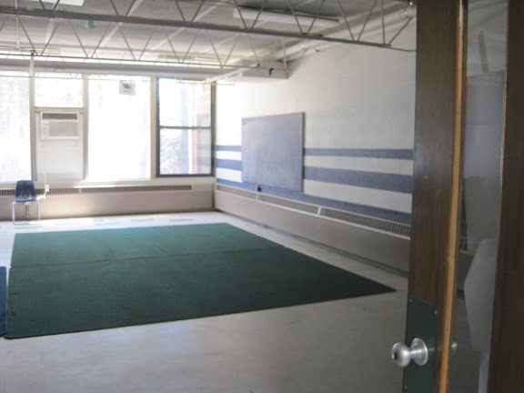
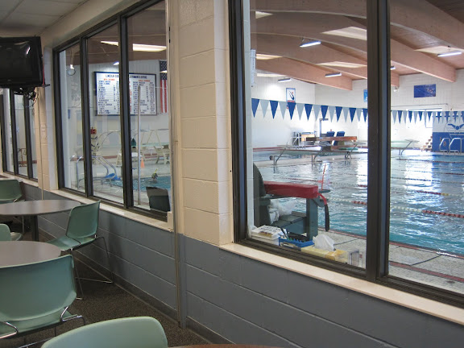
Parks and
Rec Space
PRD Reception, Weston
Preschool Hall, Concord
Fitness Room, Sudbury
Pool, Sudbury

Slide 15
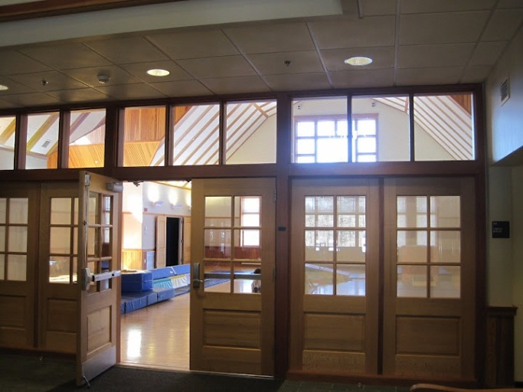
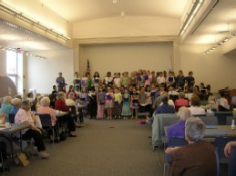
Common
Space
Common Gym, Weston
Auditorium, Concord

Slide 16
Benefits / Challenges
Promotes community-building through multi-generational interactions
Reduces stigma associated with aging; provides for a continuum of activities rather than age segregation (fitness, etc.)
Cost-efficiencies through space-sharing (19,300 co-located vs. 24,300 separate facilities)
Coordinating schedules can be difficult
Notes:
Carolyn

Slide 17
Location Assessment Summary
Site | Use | Location | Adaptability of Existing Structures | Financial Costs | Access, Circulation, Parking
Hartwell | COA |  |  |  | 
 | PRD | ★ |  |  | 
 | Co-Locate |  |  |  | 
Smith | COA |  |  |  | 
 | PRD | ★ |  |  | 
 | Co-Locate |  |  |  | 
Pierce House | COA |  |  |  | 
 | PRD |  |  |  | 
 | Co-Locate |  |  |  | 
The Groves | COA |  |  | ? | 
 | PRD | N/A | N/A | N/A | N/A
 | Co-Locate | N/A | N/A | N/A | N/A
First Parish | COA | ★ |  | ? | 
 | PRD |  |  | ? | 
 | Co-Locate |  |  | ? | 
Farrington | COA |  |  | ? | 
 | PRD |  |  | ? | 
 | Co-Locate |  |  | ? | 
Wells Road | COA |  |  | ? | 
 | PRD |  |  | ? | 
 | Co-Locate |  |  | ? | 
Key:  Excellent;  Good;  Poor; ? Needs Further Study
Notes:
Dan

Slide 18
Evaluation of Sites
Ballfield Road the only site that would accommodate a co-located facility including both COA and Rec due to proximity to the schools
Other sites would only be for a senior center and other community activities
Other sites have advantages but also significant disadvantages for even a senior center and other community activities
Notes:
Dan

Slide 19
Next Steps
We’d like your feedback and suggestions…
Notes:
Dan

Slide 20
Q & A
Notes:
Noah

Slide 21
Summary of Sites
Ballfield Road PROS: good location, adaptability of existing structures, circulation and access CONS: buildings currently in use, wetlands
Pierce House PROS: good location, adequate parking CONS: current building lacks space and accessibility, requires construction of new facility or addition, is a historic structure

Slide 22
The Commons PROS: building could be adapted, accessible CONS: Not conveniently located for those not at The Commons, need to pay rent, may affect taxes and affordable housing
First Parish Stone Church PROS: good location, good parking and circulation, structure could be adapted CONS: need to pay rent, space currently in use by The Birches, need to share space with church

Slide 23
Farrington Memorial PROS: current structure could be adapted CONS: not centrally located and difficult to access, significant renovations needed, new parking lot would use current open space
Wells Road PROS: centrally located and close to many seniors CONS: significant construction or renovation needed, lack of parking, financial arrangements unclear, environmental impact of new building on open space and sewage

