Slide 1
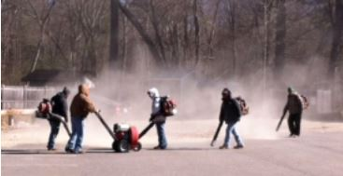
Leaf Blowers and Lincoln
Jamie Banks, PhD
For the Town of Lincoln Leaf Blower Study Committee
August 2013

Slide 2
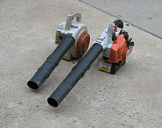
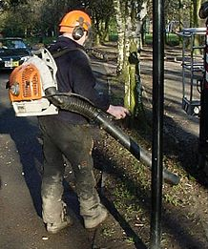
Leaf Blower Basics
Mainly 2-stroke engines, some 4-stroke*
No emissions controls
Inefficient burning of fuel
Grade
Commercial
Residential
Power source
Gasoline
Electric
Physical configuration
Handheld
Backpack (commercial)
*The burning of lubricating oil and the exhaust of un-burnt fuel in a 2-stroke engine makes it more polluting than a 4-stroke engine of similar power.

Slide 3
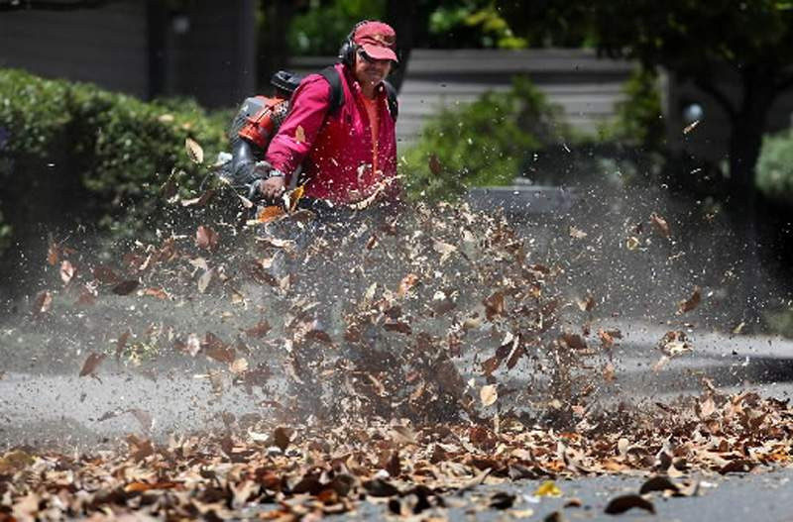
Leaf Blowers: A Major Point Source of Harmful Pollution
Noise
High decibel levels
Pure tone component
Carries over long distances
Penetrates windows and walls
Air
Toxic emissions (gas-powered)
Particulate matter (dust)

Slide 4
Noise

Slide 5
Outdoor Noise Standards
Organization | Maximum Noise level
US EPA | 55 dB for average residential outdoor noise
World Health Organization | 55 dB during the day, 45 dB during the night for steady, continuous noise.

Slide 6

Leaf Blower Noise
Noise per leaf blower =70−75 dB at 50 ft (approx 1000x ambient level)*
100+ dB at the ear of the operator and those in close proximity
Multiple machines generate higher noise levels
Irritation and intolerability of leaf blower noise is exacerbated by:
“Pure tone” (narrow frequency) component
Frequent throttling up and down
Penetrates through walls and windows
*Each 10 point increase in dB level represents a 10-fold increase in noise level; ambient noise is generally in the range of 45 dB.

Slide 7
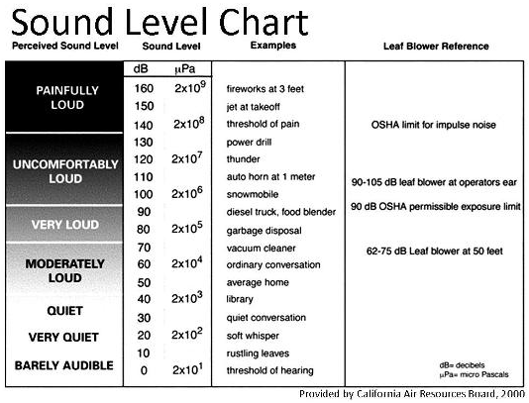

Slide 8

Noise Pollution Has Serious Health Effects
Children and elderly are most vulnerable
Hearing loss
Tinnitus
Cardiovascular effects
Immune system suppression
Stress hormone release
Sleep disturbance
Impaired childhood development
Impaired cognition
Mental health problems
Reduced work and school productivity
Reduced quality life
Key Sources: World Health Organization. Burden of disease from environmental noise: Quantification of healthy life years lost in Europe. 2011; American Speech-Language-Hearing Association, Audiology Series; Home, Community, and Recreational Noise; American Psychological Association; Noise Pollution Clearinghouse; Babisch W. Noise Health. 2006;8:1-29. Stansfeld S, Crombie R. Noise Health. 2011;13:229-33.

Slide 9
HYENA Study on Airport Noise*
Effects of aircraft noise on sleeping subjects
Subjects (including those who stayed asleep) experienced:
blood pressure spikes
increased pulse rates
vasoconstriction
stress hormone release
Harmful cardiovascular responses affected individuals for many days
There is no physiological habituation to noise. The stress of audible assault affects us psychologically even when we don’t consciously register noise.
---Dr Wolfgang Babisch, leading noise researcher
*HYpertension and Exposure to Noise Near Airports study published in 2009

Slide 10
…the scientific evidence shows that loud sound is physically debilitating. A recent World Health Organization report on the burden of disease from environmental noise conservatively estimates that Western Europeans lose more than one million healthy life years annually as a consequence of noise-related disability and disease.* Among environmental hazards, only air pollution causes more damage.
---George Prochnik, NY Times, Aug 24, 2013
George Prochnik is author of In Pursuit of Silence: Listening for Meaning in a World of Noise (Doubleday, 2010).
*Source: Burden of Disease from Environmental Noise: Quantification of Healthy Life Years Lost in Europe. Copenhagen: World Health Organization, 2011.

Slide 11
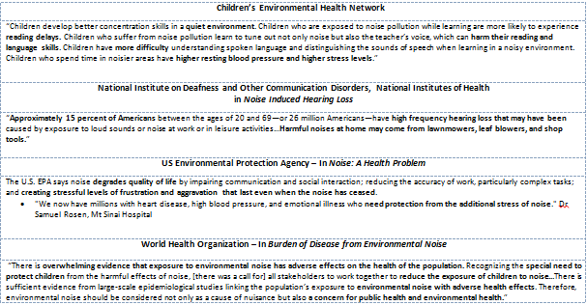
Scientific Statements on Health Effects of Leaf Blower Generated Noise Pollution

Slide 12
Sample of References on Noise and Health
Babisch W. Transportation noise and cardiovascular risk: updated review and synthesis of epidemiological studies indicate that the evidence has increased. Noise Health. 2006;8:1-29.
Burden of Disease from Environmental Noise: Quantification of Healthy Life Years Lost in Europe. Copenhagen: World Health Organization, 2011.
Children and Noise. Children's Health and the Environment, WHO Training Package for the Health Sector, World Health Organization (http://www.who.int/ceh/capacity/noise.pdf)
Crombie R, Clark C, Stansfeld SA. Environmental noise exposure, early biological risk and mental health in nine to ten year old children: a cross-sectional field study. Environ Health. 201;10:39.
Jarup L, Babisch W, Houthuijs D, et al. Hypertension and exposure to noise near airports: the HYENA study. Environ Health Perspect. 2008;116:329-33.
Kaminski J. Environmental and Health Effects of Using Leaf Blowers.1998.
Stansfeld S, Crombie R. Cardiovascular effects of environmental noise: research in the United Kingdom. Noise Health. 2011;13:229-33.
van Kamp I, Davies H. Noise and health in vulnerable groups: a review. Noise Health. 2013;15:153-9.

Slide 13

Noise Pollution Also Affects Wildlife
A growing number of studies indicate that wildlife, like humans, are being adversely affected by noise-related stresses
Examples (Barber et al, 2009):
The endangered Sonoran pronghorn avoids noisy areas frequented by military jets
Female frogs exposed to traffic noise have more difficulty locating the male's signal
Gleaning bats avoid hunting in areas with road noise.
Combined with other stressors, sound may have substantive impacts on the health and vitality of wildlife populations.
Key Sources: National Park Service, Wildlife Conservation Society; Barber JR, Crooks KR, Fristrup KM. Trends in Ecology and Evolution, 2010; 25:180-89.

Slide 14
Other Impacts of Noise Pollution
Decline in property values (Nelson, 2008)
People moving from homes
Nelson JP. Ch 3 in Hedonic Methods in Housing Markets: Pricing Environmental Amenities and Segregation, Springer, 2008.

Slide 15
Air Pollution

Slide 16
Air Pollution from Leaf Blowers
Exhaust emissions (gas-powered blowers)
Particulate matter (dust)

Slide 17
Exhaust Emissions from Leaf Blowers
Hydrocarbons from burned and unburned fuel
Combine with other gases in the air to form ozone
Carbon monoxide
Fine particulate matter (≤2.5 microns; PM_{2.5})
Other toxic, carcinogenic compounds from unburned fuel, including benzene, 1,3-butadiene, acetaldehyde, and formaldehyde
Key Sources: A Report to the California Legislature on the Potential Health and Environmental Impacts of Leaf Blowers. California Environmental Protection Agency, Air Resources Board, Mobile Source Control Division, February 2000.

Slide 18
Health Effects of Leaf Blower Exhaust Emissions
Hydrocarbons and nitrogen dioxide can form ozone in the presence of sunlight.
Ozone is a strong respiratory irritant cause airway constriction, coughing, sore throat, and shortness of breath.
Carbon monoxide is poisonous.
Effects range from headaches, dizziness, weakness, and nausea, to death.
Children and people with heart disease are especially vulnerable.
Key Sources: A Report to the California Legislature on the Potential Health and Environmental Impacts of Leaf Blowers. California Environmental Protection Agency, Air Resources Board, Mobile Source Control Division, February 2000.

Slide 19
Health Effects of Leaf Blower Exhaust Emissions
Benzene, 1,3-butadiene, acetaldehyde, and formaldehyde are toxic and carcinogenic.
PM_{2.5} can remain suspended in the air for days and can lodge deep within the lungs.
Increases the number and severity of asthma attacks, bronchitis and other lung diseases, and reduce ability to fight infections.
Children and the elderly are especially vulnerable.
Key Sources: A Report to the California Legislature on the Potential Health and Environmental Impacts of Leaf Blowers. California Environmental Protection Agency, Air Resources Board, Mobile Source Control Division, February 2000.

Slide 20

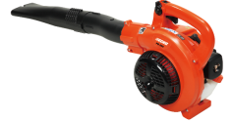
Environmental Impact: AAA Testing Lab Demonstration
Comparison
Results
Hydrocarbon emissions from 30 minutes of yard work with a 2-stroke leaf blower = 3,900-mile drive from Texas to Alaska in a Ford Raptor.
A Ryobi 4-stroke leaf blower generated ~7x more NOx and 13.5x more CO vs the Raptor.
An Echo 2-stroke leaf blower generated 23x CO and ~300x more non-methane hydrocarbons vs the Raptor.
vs
6,200-pound, 400+ hp 2011 Ford F-150 SVT Raptor
Hand held 2-stroke leaf blowers – 2 models
Details at http://www.insideline.com/features/emissions-test-car-vs-truck-vs-leaf-blower.html.
Photos at: http://www.insideline.com/features/photos/emissions-test-car-vs-truck-vs-leaf-blower-gallery.html.

Slide 21

A Large Carbon Footprint
Small, handheld two-stroke lawn and garden machines, such as leaf blowers
Account for 5–10% of total US emissions of carbon monoxide, nitrous oxides, hydrocarbons and PM_{2.5}
Leaf blower vs 1999- 2000 model car
Particulate matter = 49x greater
Carbon monoxide = 26x greater
Hydrocarbon emissions = 510x greater
*Source: US Environmental Protection Agency. Volckens J, Olson DA, Hays MD. Carbonaceous species emitted from handheld two-stroke engines. Atmospheric Environment 2008;42: 1239-1248; Higgins A. A Growing Clamor Over Leaf Blowers. Washington Post, 11/9/06.

Slide 22
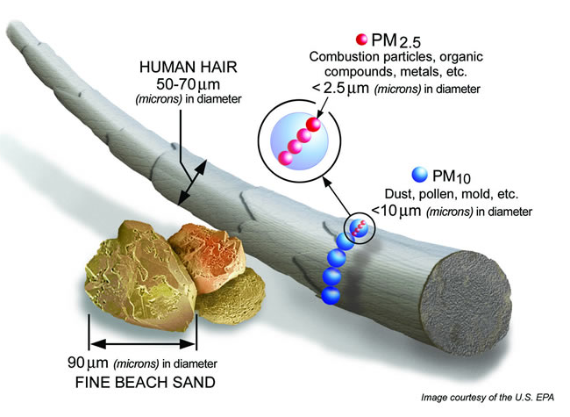
Particulate Matter

Slide 23
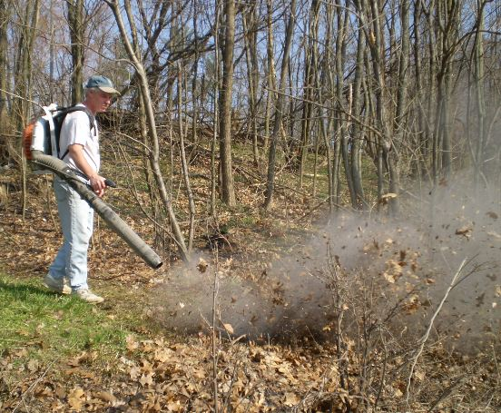
Dust (Particulate Matter) Emissions
Each leaf blower (150−280 mph air jet) held close to the ground
Generates 2−3 pounds PM/hour
Composition
Animal fecal material
Fertilizers, pesticides, herbicides
Fungal spores, pollen
Diesel soot, brake dust, rubber tire particles
Toxic metals (eg, arsenic, chromium, lead, and mercury)
Key Sources: A Report to the California Legislature on the Potential Health and Environmental Impacts of Leaf Blowers. California Environmental Protection Agency, Air Resources Board, Mobile Source Control Division, February 2000.

Slide 24

Dust Particulate Matter: Health Effects
A non-controversial link between particulate matter and increased health risks has been shown
Asthma
Pneumonia
Bronchitis
Premature death in people with pre-existing conditions
Most vulnerable: Infants and children, elderly, and persons with heart and lung disease
Key Sources: US EPA. Integrated Scientific Assessment of Particulate Matter, 2009. Brook RD, et al. American Heart Association Scientific Statement: Particulate Matter Air Pollution and Cardiovascular Disease, An Update to the Scientific Statement From the American Heart Association. Circulation. 2010;121:2331-2378.

Slide 25
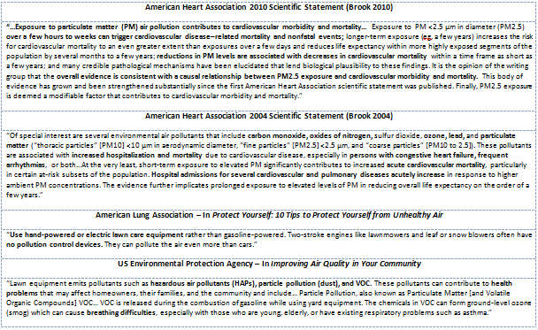
Scientific Statements on Health Effects of Leaf Blower Generated Air Pollution

Slide 26
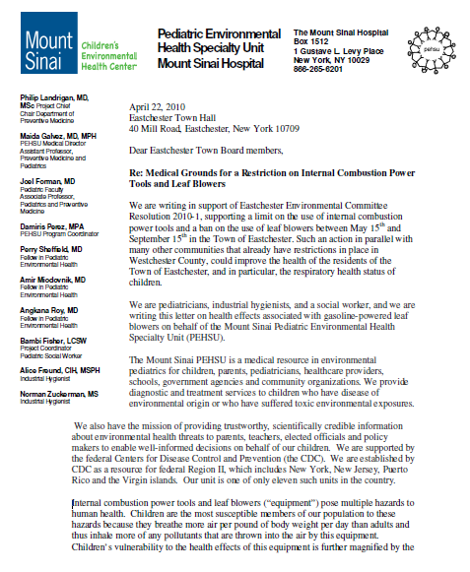
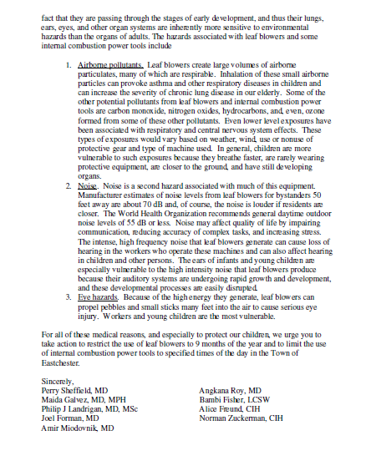
Children are uniquely vulnerable

Slide 27
Sample of References on Health Effects of Leaf Blower Generated Air Pollution
A Report to the California Legislature on the Potential Health and Environmental Impacts of Leaf Blowers, Air Resources Board, State of California, February 2000. (Available at: http://www.arb.ca.gov/msprog/mailouts/msc0005/msc0005.pdf)
Integrated Science Assessment for Particulate Matter, US Environmental Protection Agency, 2009 (Available at: http://www.epa.gov/ncea/pdfs/partmatt/Dec2009/PM_ISA_full.pdf)
Brook RJ, Rajagopalan S, Pope CA, et al. Particulate Matter Air Pollution and Cardiovascular Disease: An Update to the Scientific Statement of the American Heart Association: Statement From the American Heart Association. Circulation. 2010;121:2331-2378.
Correia AW, Pope CA, Dockery DW, et al. Effect of Air Pollution Control on Life Expectancy in the United States An Analysis of 545 U.S. Counties for the Period from 2000 to 2007. Epidemiology 2013;24: 23–31.
Dominici F, Peng RD, Bell MI, et al. Fine Particulate Air Pollution and Hospital Admission for Cardiovascular and Respiratory Diseases. JAMA 2006;295:1127-1134.
Fitz D, Pankratz D, Pederson S, et al. Determination Particulate Emission Rates from Leaf Blowers.

Slide 28
Sample of References on Health Effects of Leaf Blower Generated Air Pollution
Fitz DR, et al. Particulate Matter Emissions Factors and Emissions Inventory from Leaf Blowers in Use in the San Joaquin Valley – Final Report. Prepared for: San Joaquin Valley Unified Air Pollution Control District, Jan 27, 2006.
Gauderman JW, Gilliland GF, Vora H, et al. Association between Air Pollution and Lung Function Growth in Southern California Children: Results from a Second Cohort. Am J Respir Crit Care Med 2000;162:1383–1390
Laden F, Schwartz J, Speizer FE, et al. Reduction in Fine Particulate Air Pollution
and Mortality Extended Follow-up of the Harvard Six Cities Study. Am J Respir Crit Care Med 2006;173:667–672.
Lepeule J, Laden F, Dockery D, et al. Chronic Exposure to Fine Particles and Mortality: An Extended Follow-up of the Harvard Six Cities Study from 1974 to 2009. Environ Health Perspect 2012;120:965–970.
Mustafic H, Jabre P, Caussin C, et al. Main Air Pollutants and Myocardial Infarction
A Systematic Review and Meta-analysis. JAMA. 2012;307:713-721.
Volckens J, Olson DA, Hays MD. Carbonaceous species emitted from handheld two-stroke engines. Atmospheric Environment 2008;42:1239-48.

Slide 29
Ecological Impact

Slide 30

Injury to wildlife, habitats, and ecosystems with noise and pollution
Birds
Small mammals
Beneficial insects
Nest disturbance/destruction
Desiccation of pollen, sap, and other natural plant substances

Slide 31
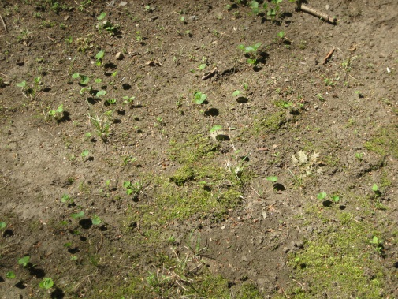
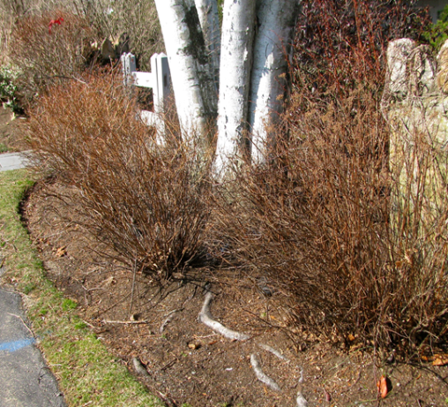
Destruction of natural landscape and ecosystems
Plant damage from high velocity airjet – leaf loss, broken branches
Topsoil desiccation, compaction and loss
Loss of life-giving mulch for nutrients, protection, plant health
Spread of plant diseases
Water pollution

Slide 32
Lincoln

Slide 33


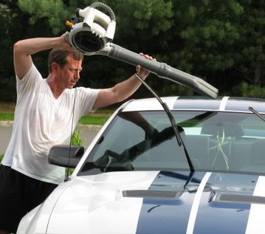

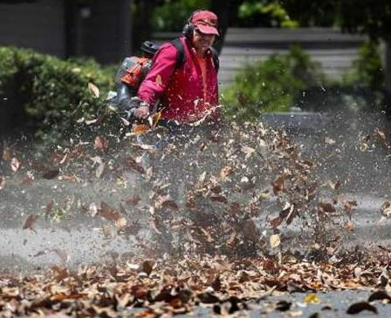
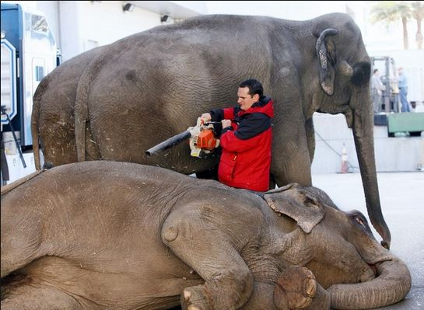
More frequent use, expanding applications
Use and duration of often disproportional to nature of task

Slide 34

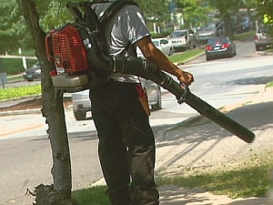
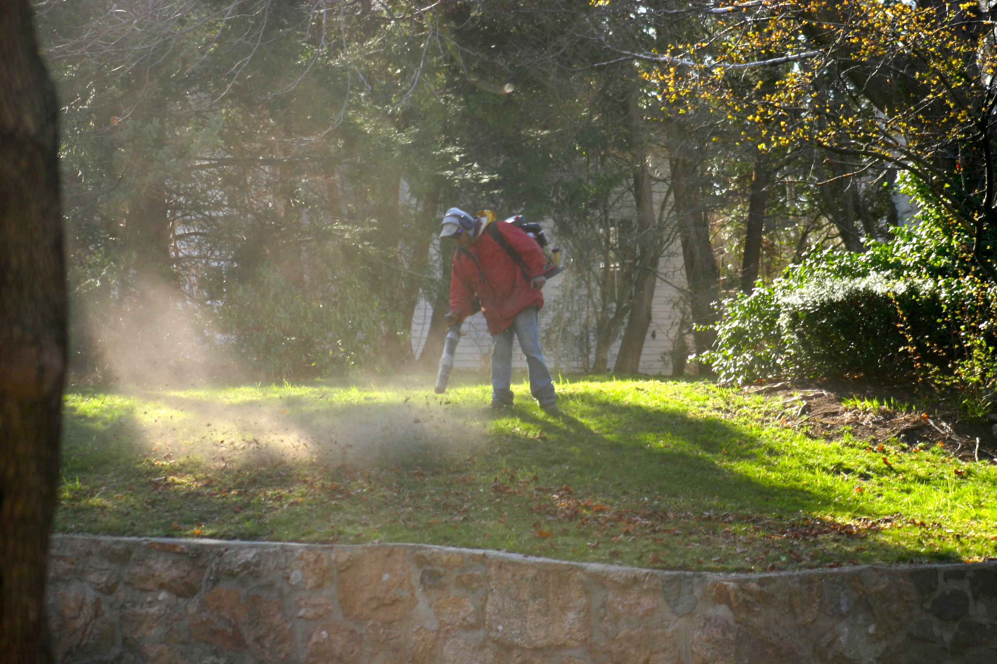
Three seasons out of four

Slide 35
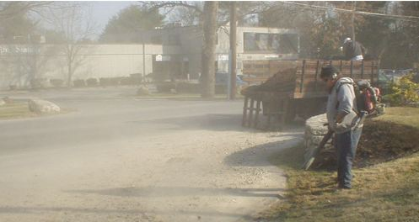
Lincoln Station, Autumn 2012
2−8 hour daily exposure to high dB noise on 50% of days from September 1−mid-December, including weekends
Multiple commercial-grade leaf blowers used at 11 surrounding commercial and residential developments*
Used mainly on pavement – regardless of need; rarely used for leaves
Decibel levels up to 85−90 dB recorded at commercial-residential property lines
Violates the community standard of >10 dB above ambient defined in MA DEP 310 CMR 7.1.
*Blakely bldgs, Cambridge Trust, Flying Nun condos, Lincoln Woods, Mall at Lincoln Station, Peace Garden, Doherty’s Garage, Ridge Road Condos, Ryan Estates, St Joseph’s Church, 3S Building,

Slide 36
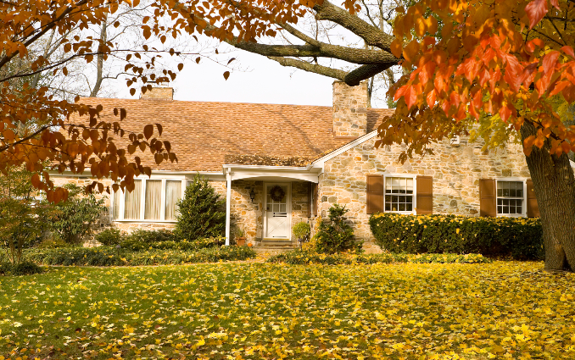
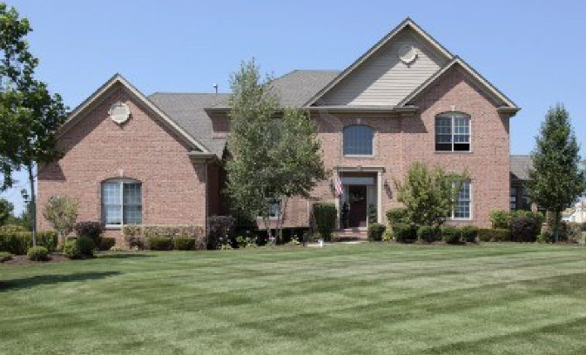
Lincoln residential neighborhoods and public lands
Then
Now
Similarly frequent exposure happening in some residential neighborhoods, esp with contracted landscape companies
Disappearing use of rakes, brooms; greater dependence on leaf blowers
Tendency to manicured vs natural look; “demon-ization” of leaves
Noise from 1 home affects many homes and conservation lands

Slide 37

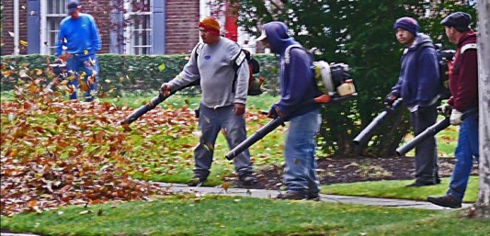
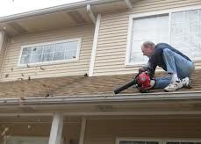
Manufacturer Guidelines – Not Applied in Real World
Dust
Not for moving dusty materials
Don’t point in direction of people or pets
Use at least 50 feet away from people
Noise
Run blowers only at RPMs needed
No full throttle in residential areas
Don’t use >1 blower at a time
Time
Do not use leaf blowers late in the evening or early in the morning
Other
Don’t use on a ladder, roof, tree or other unstable surface
Sources: Manufacturer (ECHO and Stihl) training materials

Slide 38
Lincoln’s Master Plan: Noise Goal*
NR-3.4. Adopt noise pollution regulations, with clear standards to deﬁne noise disturbance.
Some communities in Massachusetts have recently adopted bylaws and ordinances to regulate oﬀensive noise.
Lincoln could establish a working group or committee that includes staﬀ and designees of the Conservation
Commission to review the town’s options for a workable noise-reduction bylaw and the administrative requirements for implementing it. Factors to consider in any noise bylaw include not only a clear deﬁnition of oﬀensive noise and ambient noise, but also the sources of noise and noise-generating activities that will be regulated under the bylaw, the intensity, duration, and frequency of regulated noises that would constitute an oﬀense, and activities that would be exempt, e.g., emergency work, special events, or the operation of farming equipment.
*Chapter 3, page 75

Slide 39
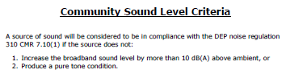
MA DEP Noise Regulation

Slide 40
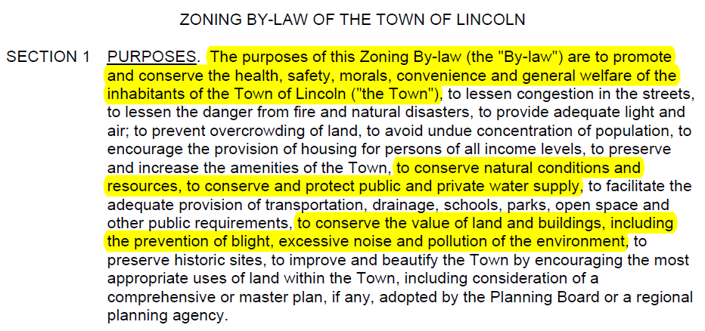
Purposes of Lincoln’s Zoning Bylaws

Slide 41
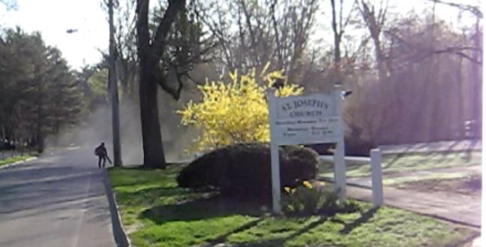
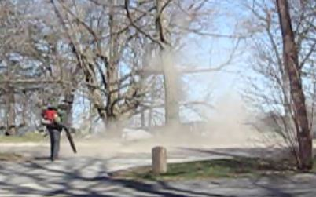
How often does this happen in Lincoln?
Does this constitute “landscaping”? “gardening”? “cleaning up”?
How many pounds of dust are produced? How long does it take to clear from the air?
What level of dust and noise are people exposed to? For how many hours?
Is this good for the health of our children and families?
Is this good for our ecosystems?
Do we want this in our neighborhoods? Our town?

Slide 42
Other Communities

Slide 43
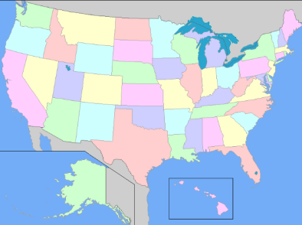
Actions
Hundreds of communities in the US and worldwide have enacted or are trying to enact restrictions on leaf blowers*
In MA: Arlington, Brookline, Cambridge, Framingham, Marblehead, Newton, Swampscott, Wellesley
Some states have considered banning leaf blowers (eg, Hawaii)
Israel enacted a national ban

Slide 44
Ban/Ordinance Variables
Full bans on:
all leaf blowers
gasoline leaf blowers only
Seasonal bans
Limiting use to
certain hours of the day;
certain days of the week;
Limiting the number of leaf blowers allowed on:
one parcel of land at a time
Limiting decibel levels
Defining allowable distance from property lines
Phase-out programs may be mandated over a number of years.

Slide 45
Alternative Solutions

Slide 46
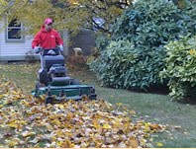

Leaf Mulching
Saves money
Saves effort
Keeps your property healthy
Helps the planet
Program implemented in Irvington, NY and expanding to surrounding towns
Go to Love ‘Em and Leave ‘Em at: www.leleny.org

Slide 47
Quiet landscape maintenance companies
Ask existing landscape companies not to use leaf blowers*
Use companies that are willing to use quiet, green alternatives for routine maintenance
Quiet Lincoln and Greening Lincoln will make public a companies
A California survey showed no reports of companies going out of business or raising rates as a result of bans. Responses included "There are still plenty of gardeners working in Berkeley" and "Gardeners are alive and well in Los Altos...there have been no complaints from the public [about higher rates].“ (http://www.nonoise.org/quietnet/cqs/ other.htm)

Slide 48
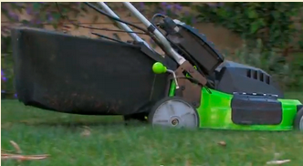
Green Equipment and “Green Zoning”
Solar powered
Lithium battery powered
No emissions
Substantial noise reduction
Green Zoning Objective: To substantially reduce elevated noise levels and exposure to harmful emissions caused by the use of gasoline powered property maintenance equipment. Learn more at: www.thegreenstationla.com

Slide 49
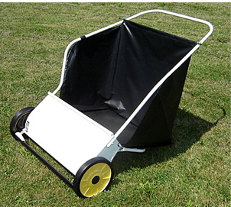
Leaf/lawn sweepers
Picks up leaves ten times faster than a rake!
No bending required, reducing back strain
Sweeps everything from lawn to driveway

Slide 50
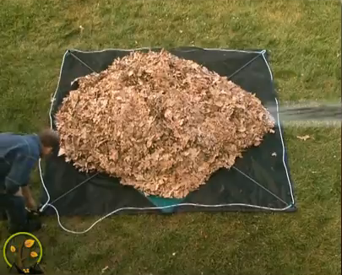
Leaf Nets and Tarps
The Leaf Lugger
Residential and commercial sizes
http://www.leaflugger.com/leaflugnet.html
Yard nets
http://www.youtube.com/watch?v=1qFaKka2DAI
The Leaf Lugger http://www.leaflugger.com/leaflugnet.html

Slide 51
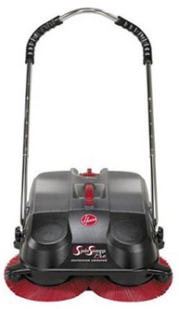
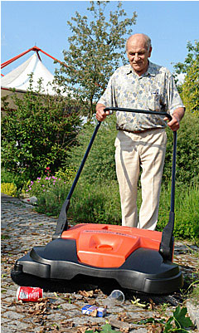
Hard surface sweepers
Hoover SpinSweep
Haaga Sweeper
http://hoover.com
Videos
https://www.youtube.com/watch?v=iI9kI-hfKa8
http://www.youtube.com/watch?v=BV2uogKAyKI

Slide 52
Hard surface sweepers
Quiet, clean
No air or noise pollution, no energy consumption
Efficient, ergonomic
Works inside and outside, in wet and dry
Sweeps up coarse and fine materials (eg, leaves, stones, paper, cans, cups, glass, large debris, sand, dirt)
Eyes and lungs protected from dust and mold

Slide 53
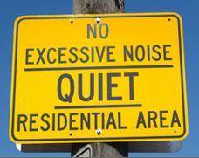
Other

