Slide 1




Complete Streets Prioritization Plan Update
Public Forum
Town of Lincoln
October 27, 2022

Slide 2
What is a Complete Street?
“A Complete Street is one that provides safe and accessible options for all travel modes – walking, biking, transit and vehicles – for people of all ages and abilities.”
Improvements may be large scale, such as corridor wide, or focused on a single mode at a single location
Improvements should be context sensitive

Slide 3
Benefits of Complete Streets
Improves safety for all users
Accessibility
Health
Promotes climate friendly transportation modes
Promotes sustainability through responsible stormwater management
Benefits all users of all ages and abilities
  Children
  Seniors
  Those with disabilities
  Those without access to a car

Slide 4
Complete Streets Funding Program
Program began February 2, 2016 with MassDOT Capital Investment Plan providing funding in FY17.
Effective FY2022, municipalities can receive a maximum award of $400,000 in funding within any four-year fiscal year timeframe.
If the project costs more than the funding the town is eligible for, they must include the amount they will need covered by other funding sources.
Projects must be fully designed. Funds cannot be used for design.
Program cannot be used for projects on State-owned roads.
  Route 2
  Route 2A
A municipality can apply for the next project only when the previous one has been completed.
Public Engagement is recommended to identify issues and areas for improvement.
FY21, MassDOT awarded $6.05 million to 18 communities including Lincoln.

Slide 5
Program Framework
Tier 1: Training and Complete Streets Policy Development
Town of Lincoln’s Complete Streets Policy approved in 2017.
Tier 2: Complete Streets Prioritization Plan Development
First Tier 2 plan approved in 2017. Plan is good for five years.
This is the Second Tier 2 plan.
Tier 3: Project Approval and Notice to Proceed for Construction
A community may update their prioritization plan after successful implementation or a change in local priorities through public engagement.

Slide 6
Prioritization Process
Review
Review existing plans, studies, and reports
Map
Review existing conditions. Map areas of safety concern and potential demand
Gather
Gather crash data, needs data, and feedback from the community, town officials, and the working group.
View
View through an equity lens
Identify
Work with the Town to identify a list of projects
Prioritize
Prioritize projects based on data, feedback, safety, and feasibility

Slide 7
Plan Review
Bicycle and Pedestrian Master Plan 2023
Village District Traffic Assessment 2020
Town of Lincoln Complete Streets Policy 2017
Lincoln Open Space Plan 2017
Lincoln Housing Plan 2014
Town of Lincoln Comprehensive Plan 2009

Slide 8
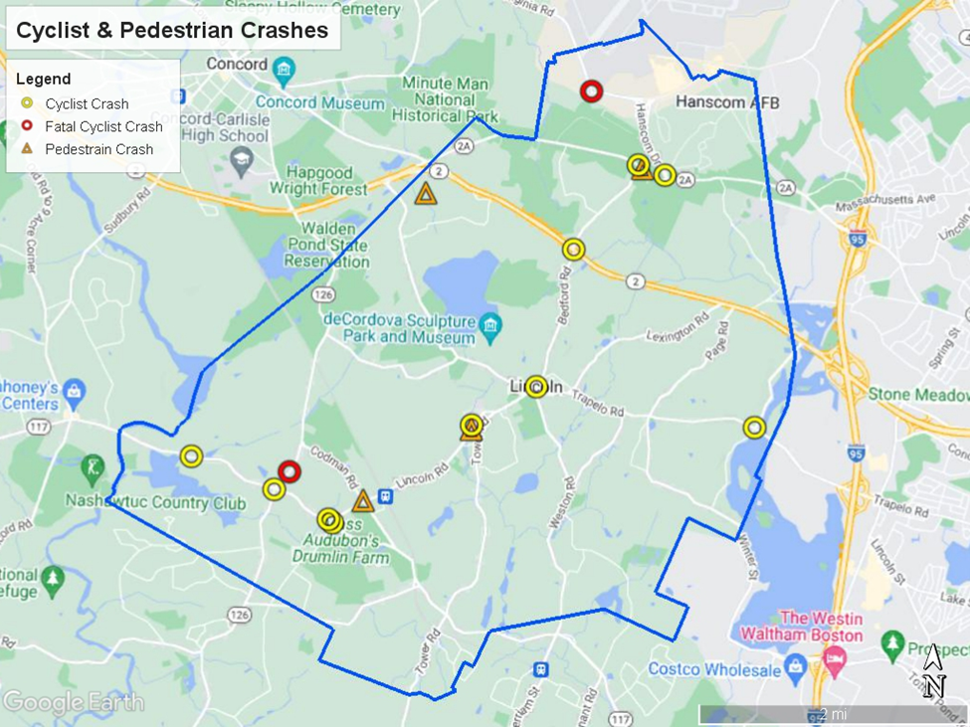
Determining Deficient Conditions

Slide 9
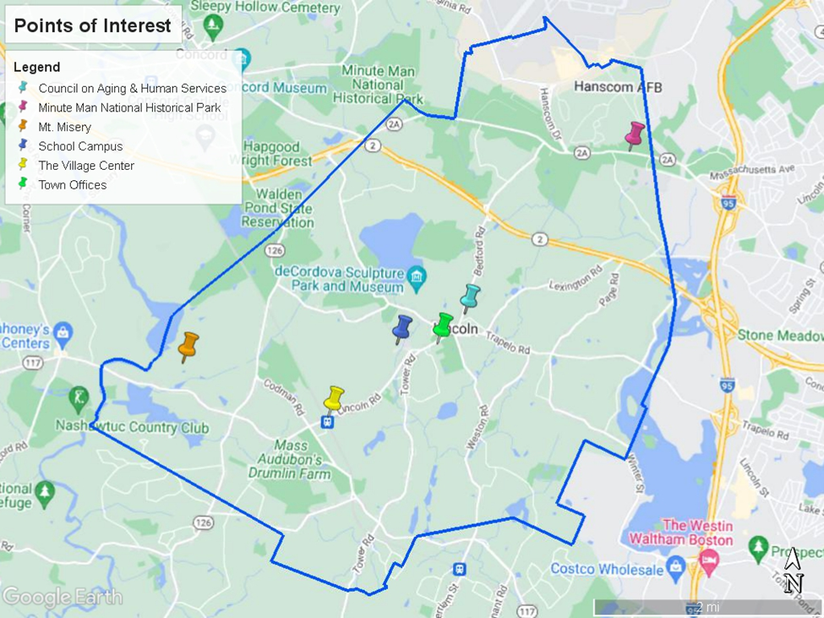
Assessing Demand

Slide 10
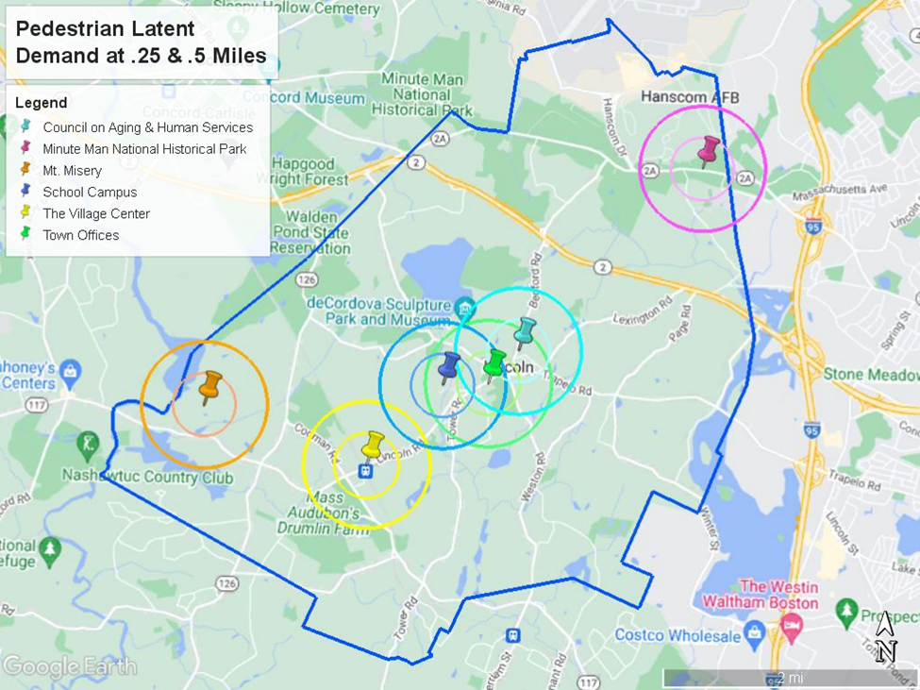
Pedestrian Demand

Slide 11
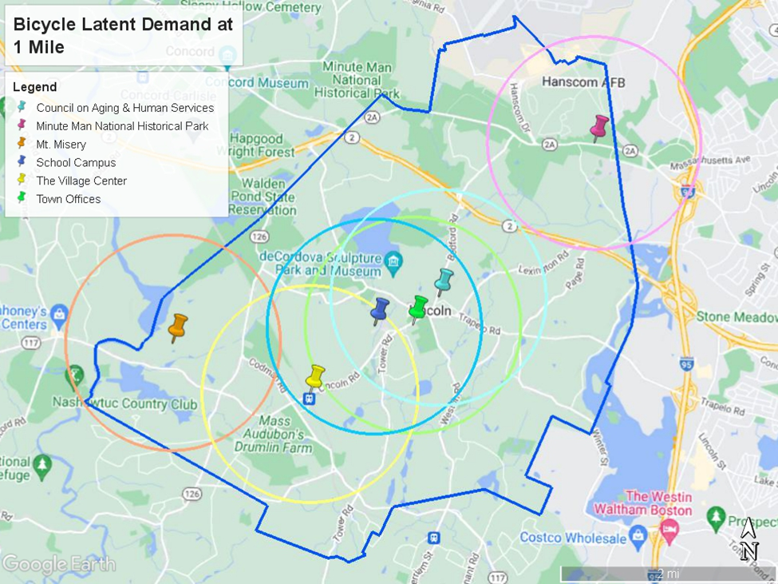
Bicycle Demand

Slide 12
Public Engagement
Please visit Wikimapping at https://wikimapping.com/lincoln_completestreets.html
  Complete the short survey on the wikimapping page and give us your thoughts on transportation.
Opportunity for feedback via this google form https://forms.gle/GW68r673QBcmKP83A or by emailing the Planning and Land Use Director: vaughnp@lincolntown.org
We will now take a short poll, then break out into small groups and reconvene where each group will report out to the larger group.

Slide 13
Next Steps
Public feedback will be incorporated.
The project list will be prioritized.
3
The final Prioritization Plan and Project List will be presented to the Planning Board and the Select Board.
4
The Plan and Project List will be submitted to MassDOT.
2
1

Slide 14
Thank You!!
Your participation is fundamental to a successful plan!!
The Complete Streets Working Group:
Margaret Olson, Planning Board and BPAC
Deborah Howe, Roadway & Traffic
Chris Bibbo, DPW Superintendent
John Vancor, Engineering Consultant
Tim Higgins, Town Administrator
Paula Vaughn-MacKenzie, Director of Planning & Land Use

