Slide 1
State of the Town Meeting
December 7, 2024
Town Meeting Study Committee Members
Ariane Liazos
Jennifer Morris-Gundy
Kenny Mitchell
Taylor Ortiz
Andrew Pang
Ben Shiller
Andy Wang
Sarah Cannon Holden – Town Moderator
Jim Hutchinson – Select Board Representative
Tim Higgins – Town Administrator, Ex-officio Member

Slide 2
Town Meeting Study Committee (TMSC)
SOTT Breakout Session Agenda (DRAFT)
Welcome and Introduction – Andrew (slides 1-2); 1 minute
TMSC Charge & Timeline – Jim (slides 3-6); 3 minutes
Town Meeting participation – Andrew (slides 7-13); 6 minutes
Public Outreach Approach – Andrew (slide 14); 2 minutes
Feedback received to date – Ben (slide 15-20); 3 minutes
Participant Feedback - Jennie (slide 21); 1 minute intro; 28 minutes feedback
Wrap-up and thank you – Andrew 1 minute

Slide 3
TMSC Charge & Timeline
Conduct a thorough study of current Town Meeting processes and procedures, including those leading up to Town Meeting
Educate residents on how the system currently works
Learn from the experience and best practices of other communities and municipal experts
Review Lincoln voter participation data versus neighboring towns
Seek Town resident input, including a Town-wide survey
Determine what’s working well and identify recommendations
Prepare a report for the Select Board and Moderator
    Interim report: March 29, 2025
    Final report: October 2025
    Report to residents: November/December 2025 at SOTT meeting

Slide 4
Our Challenges
Obtaining resident participation/feedback in public forums and survey
Stay within the boundaries of our charge
Constraints of current State law
Navigating conflicting input from residents

Slide 5
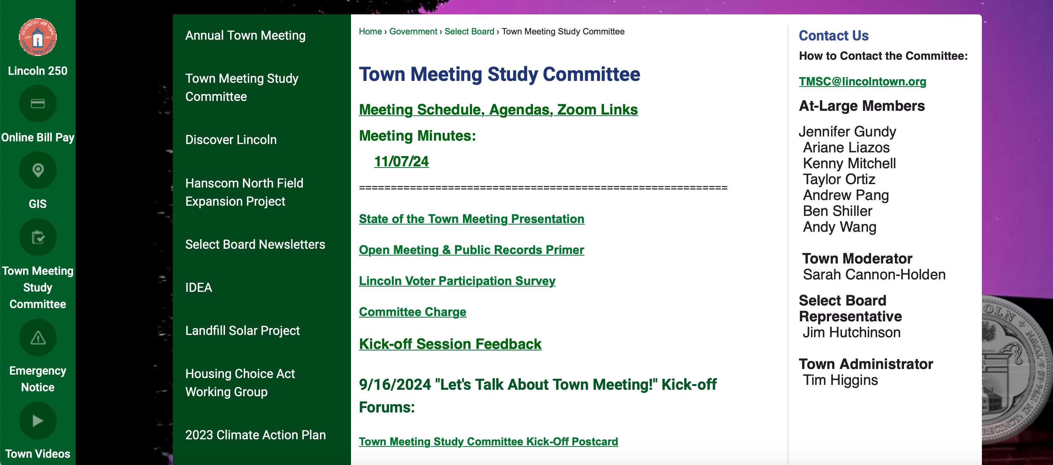
Where to find the latest information? Town Website!

Slide 6
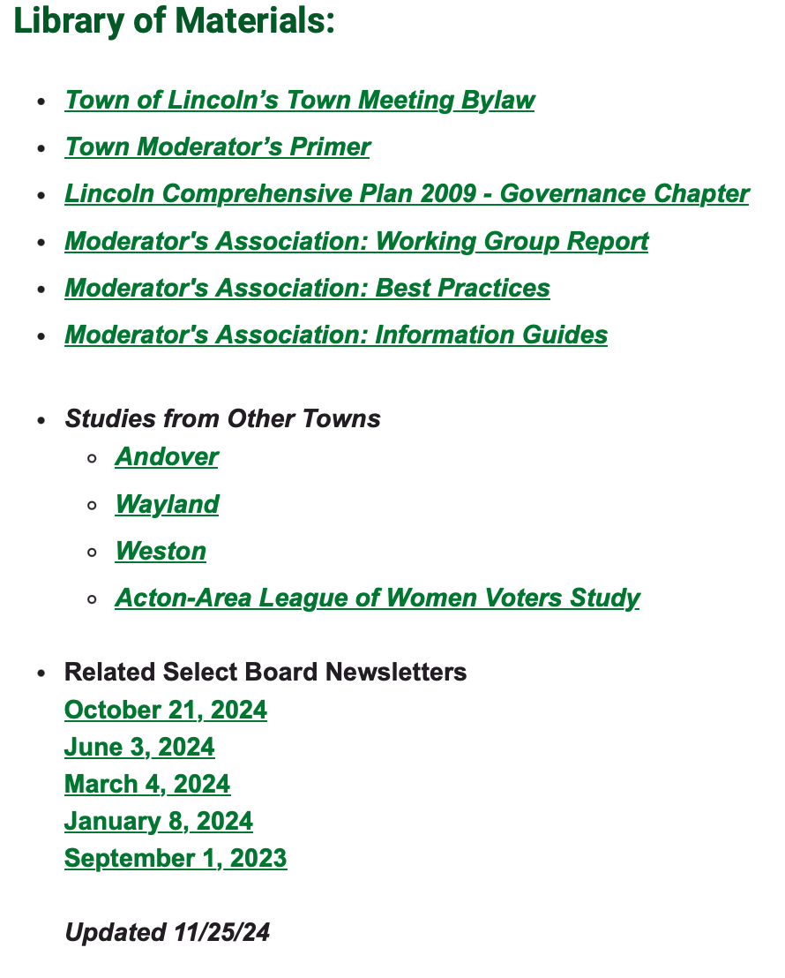
Q: Where do I find the latest information?
A: Town Website!
How to contact us?
TMSC@ lincolntown.org

Slide 7
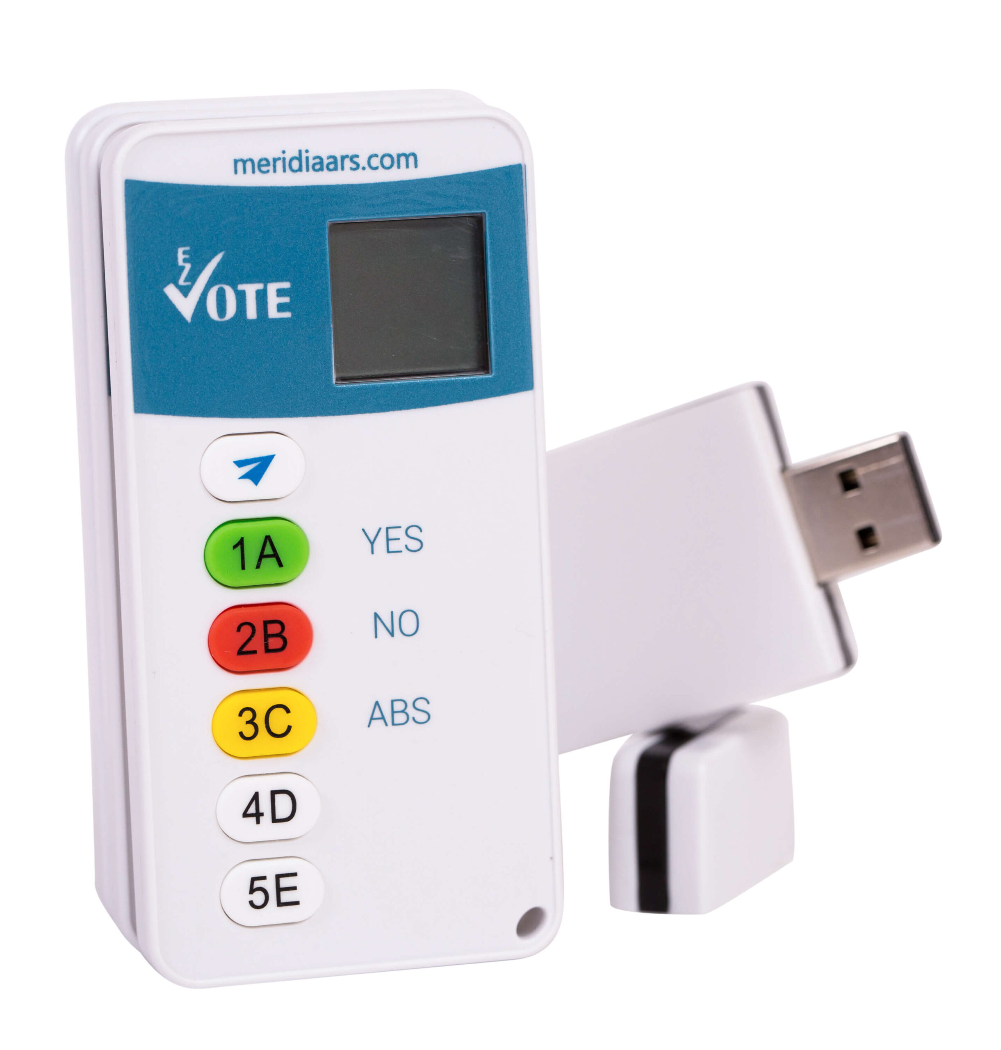
Clicker Voting Instructions
No "on" or "off" button - hit any of the buttons to wake up the clicker
Clicker will automatically “sleep” if you haven't touched a button for a while
For voting, press the button of your choice
If you change your mind while voting is still open, just hit the new button you prefer
Only the last button you press before voting is closed will be recorded as your vote
The number on your clicker screen will show your final choice

Slide 8
Which town had the highest average percentage of registered voters show up at THE POLLS over the last ten years?
Concord
Sudbury
Wayland
Weston
Lincoln

Slide 10
Which town had the highest average percentage of registered voters show up at Town Meeting over the last ten years?
Concord
Sudbury
Wayland
Weston
Lincoln

Slide 13
What causes the spikes in participation?
Girl Scouts sold cookies at those meetings
Twisted Tree offered lunch
Weather cooperated
Kids’ sporting events canceled
Expensive capital projects or zoning changes on the Warrant

Slide 14
Public Outreach & Engagement Plan
  Attend the Town Meeting Study Committee (TMSC) meetings
  Speak with any member of the committee
  Dedicated e-mail for public comments: TMSC@lincolntown.org
  TMSC dedicated webpage
  Periodic updates on communication channels throughout Town
  Periodic Select Board updates
  Town-wide survey (outside consultant) & occasional public forums
  March 29, 2025, Annual Town Meeting update

Slide 15
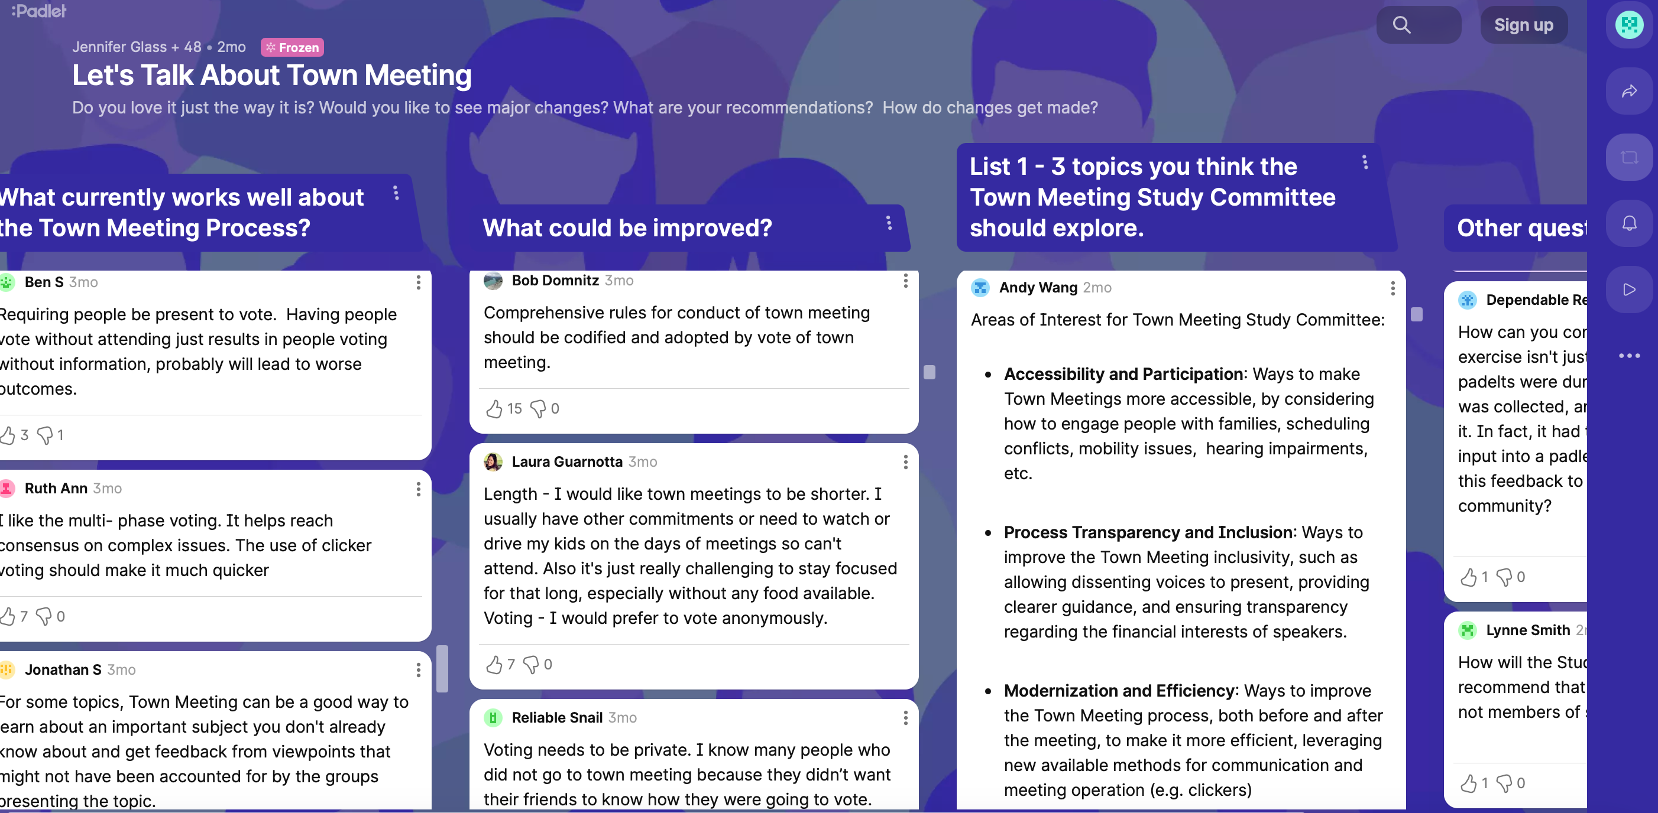
Feedback Received to Date

Slide 16
Electronic Voting
  Use clickers to save time
  Anonymous voting to reduce social pressure
  Public voting: transparency, “stand and be counted”

Slide 17
Inclusivity and Accessibility
  Make more accessible for
    Families
    Those with mobility issues
    Those unable to attend in person
  Suggestions
    Childcare
    Transportation
    Remote participation

Slide 18
Transparency and Fairness
  Clear guidelines for presentations
  Allow dissenting voices to be heard
  All viewpoints given equal time and consideration
  Explore conflict-of-interest policy (financial, other)

Slide 19
Improve Meeting Efficiency
  Split the meeting into two sessions: discussion and voting
  Tradition of one meeting, opportunities to build community
  Reduce the length of meetings
  Better manage the time for speakers

Slide 20
Civility and Respect
  Concerns about the tone and conduct of discussions leading up to and at Town Meeting
  Code of conduct to ensure respectful and productive dialogue

Slide 21
Participant Feedback – We want to hear from you!
What is on your mind?
  What is working well?
  How can Town Meeting be improved?
  Questions about the work of the Committee?
  What should we include in our work?
Write comments on handout and turn in on your way out!
Email us: TMSC@lincolntown.org

Slide 22
Where to find the latest information? Town Website!

